Slide 1
The Spiritual Brain
And Levels of Consciousness

Slide 2
Typical Beliefs
Christianity
Judaism
Science Philosophy
New
Age

Slide 3
Frames
Levels of
Consciousness
Science Philosophy
New
Age
Christianity
Judaism

Slide 4
Points of View
Different Ways of Seeing Things

Slide 5
UU is Rich in Resources
Some resources:
Christianity
Judaism
New Age
Science
Philosophy
Atheism, Agnosticism
Personal Theories

Slide 6
Why do I believe the way I do?
My belief system works for me because:
I don’t have to think about it
Its traditional
It brings peace to me
It helps me feel close to my family and friends.
It is based on science
It is based on philosophy
I really don’t think anyone knows
Its based on my own theories

Slide 7
But How Useful is Your Belief System?
Does it provide guidance?
Does it integrate into your life?
Does it enable the feelings of joy spirituality and awe?
Does it bring peace to a trouble heart?
Does it jell with what you know?
Does it help set goals, and purpose?
Is your belief system binary or flexible?
Does it help integrate your conflicts?

Slide 8
Models of the Universe?
Does it provide guidance?
Does it integrate into your life?
Does it enable the feelings of joy spirituality and awe?
Does it bring peace to a trouble heart?
Does it jell with what you know?
Does it help set goals, and purpose?
Is your belief system binary or flexible?
Does it help integrate your conflets?

Slide 9
Various Models
The physical Universe
The Revealed Truth (Religious)
Other ancient models (e.g., Aristotle)
Mind Models
Brain Models
My Universal Model

Slide 10
My Universal Model
The Superconscious Mind
The Conscious Mind
The Brain
The Physical World

Slide 11
Superconscious Mind
Peak of the Brains Hierarchy
Unconscious Reference for the 100 Billion Brain Cells
Possible Pathway To God
Probably Associated with the Frontal Brain Lobe
Knows that its Knows
I am that I am
Issues Our Deepest Beliefs and Feelings

Slide 12
The Conscious Mind
Our Awareness
Our Feelings
Our Thoughts
Our True Self

Slide 13
The Conscious Mind and Conscious Levels
High Consciousness
Ordinary Consciousness
Low Consciousness
Little Consciousness

Slide 14
Another View of Consciousness
1 Victim Consciousness - Feeling that its my fault
2 Conflict Consciousness – Conflicting Feelings
3 Responsibility Consciousness – Guilty Feelings
4 Concern Consciousness – Feeling Worried
5 Reconciliation Consciousness – Wanting to Make Up and Feel Love Again
6 Synthesis Consciousness – Feeling of Oneness, Love for a Sweetheart
7 Non-judgement Consciousness – Feeling of Love for Everything

Slide 15
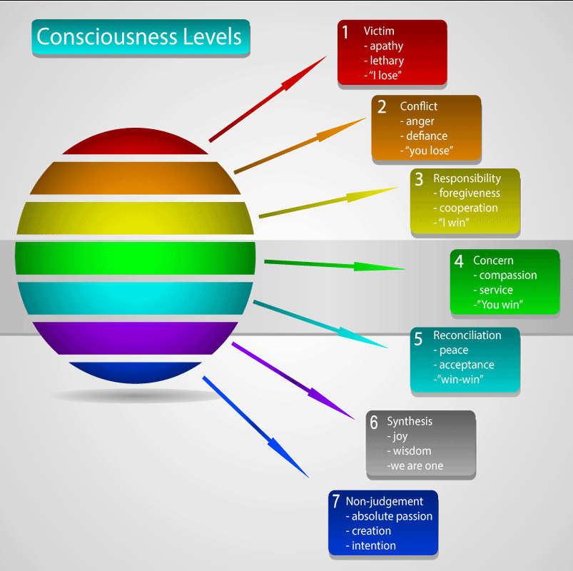
https://coaching.oncore.ventures/seven-levels-consciousness/

Slide 16
1 Victim Level
Its My Fault
Its Your Fault
Self pity
Apathy and not caring
Lethargy and lack of energy
Communication problems
Judgement

Slide 17
2 Conflict Level
Conflicting Feelings and Ideas
Anger towards others
Defiance, resistance, bold disobedience
Conversations become arguments
High, but shallow ego
Problems are projected on others

Slide 18
3 Responsibility Level
Guilty Feelings or I am Better than You
I will do it myself
Forgiveness of others
May feel guilty
High, but shallow ego
Problems are projected on others

Slide 19
4 Concern Level
Feeling Worried, Things are Wrong
Compassion for others
Focus on service
Altruism
Possible Codependence
Problems are projected on others

Slide 20
5 Reconciliation Level
Want to Make Up and Feel Love Again
Want to Find Peace and Acceptance Again
Talking together about Personal Problems
Seeking Cooperation

Slide 21
6 Synthesis Level
Feelings of Oneness and Love for Someone Special
When expanded: Joy, Wisdom for Being Alive
Being One with the universe
Being Naturally Happy No Matter What
Not taking anything personally
First Level of Higher Consciousness

Slide 22
7 Non-judgement Level
Feelings of Love for Everything and Everybody
Absolute Oneness
Being Creative in a Spiritual Way
Reaching for The Deepest Purpose
Touching the Super Consciousness
Knowing that You Know

Slide 23
The Seven UU Principles
Based on a living tradition of wisdom and spirituality
Drawn from sources including science, poetry, scripture and personal experience
Not dogma or doctrine
A guide for Unitarian Universalist religious communities

Slide 24
1st Principle: The inherent worth and dignity of every person;
Absolute passion
Creation
Intention
Have higher purpose
Spiritual Joy
Super Consciousness

Slide 25
2nd Principle: Justice, equity and compassion in human relations;
Absolute passion
Creation
Intention
Have higher purpose
Spiritual Joy
Super Consciousness

Slide 26
3rd Principle: Acceptance of one another and encouragement to spiritual growth in our congregations;
Absolute passion
Creation
Intention
Have higher purpose
Spiritual Joy
Super Consciousness

Slide 27
4th Principle: A free and responsible search for truth and meaning;
Absolute passion
Creation
Intention
Have higher purpose
Spiritual Joy
Super Consciousness

Slide 28
5th Principle: The right of conscience and the use of the democratic process within our congregations and in society at large;
Absolute passion
Creation
Intention
Have higher purpose
Spiritual Joy
Super Consciousness

Slide 29
6th Principle: The goal of world community with peace, liberty, and justice for all;;
Absolute passion
Creation
Intention
Have higher purpose
Spiritual Joy
Super Consciousness

Slide 30
7th Principle: Respect for the interdependent web of all existence of which we are a part.
Absolute passion
Creation
Intention
Have higher purpose
Spiritual Joy
Super Consciousness

Slide 33
Frontal Lobe Through Dilbert Eyes

